Slide 1
Survival Analysis based on Respiratory Cancer in Atlanta
Zheran (Rachel) Wang
Department of Mathematics and Statistics
Auburn University
Dec. 4th 2018

Slide 2
Content
Introduction
Data
Methods
Results
Conclusion

Slide 3
Introduction
SEER is a source provide by Surveillance Research Program (SRP) in NCI’s Division of Cancer Control and Population Sciences (DCCPS) for cancer statistics in the United States.
In this analysis, I chose respiratory cancer in Atlanta.
https://seer.cancer.gov/

Slide 4
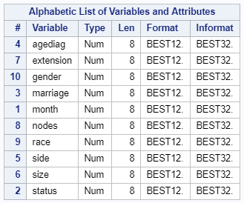
Data
Month: Survival month (response).
Status: SEER cause of death classification (status). 1 stands for event time. 0 stands for censoring.
Agediag: age of diagnosis. Age greater than 999 are unknown and get removed.
Extension: how far the tumor expand to. Range between 00-99.
Gender: 1 stands for male, 0 stands for female.
Marriage: 1 stands for married, 0 stands for single.
Nodes: Reginal Nodes Examined. In this study, only consider the exact number of nodes examined.
Side: Laterality. The side where the primary tumor found. 0 stands for no primary site. 1 stands for left side. 2 stands for right side.
Size: How big the tumor in millimeter.
Total number of observation: 6068

Slide 5
Data

Slide 6
Method
Use proc lifetest-Survival Plot
Use proc lifereg-Parametric Regression Models
fit a parametric model
Test assumption by using ProbPlot
Compare models with different distribution
Use proc phreg-Cox Proportional Hazards Regression
Fit a semi-parametric model
Test assumption by using ‘assess ph’
Check if transformation needed
Check if stratified model will be better
Stepwise selection

Slide 7
Result

Slide 8
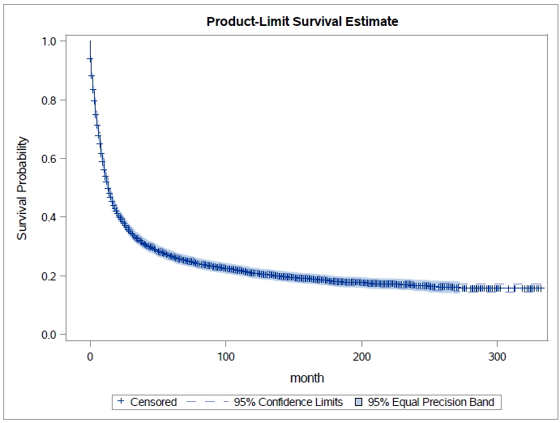
Survival Plot

Slide 9
Survival Plot with Different Group
Different gender are separated
Different marriage status are overlapped
P-value of Log-Rank test: 0.0891

Slide 10
Survival Plot with Different Group-more
For race, white and black are clearly separate.
Other race is overlapped with both black and white.
Will use Race=white as the baseline
For side, no side with lift and right sides are clearly separate.
Left side and right side are overlapped.
Will use Side=left as the baseline

Slide 11
Lifereg-Result
 | -2 Log Likelihood | AIC | BIC
Weibull | 180375.56 | 18059.56 | 18139.17
Exponential | 18770.58 | 18792.58 | 18865.56
Gamma | 17139.19 | 17165.19 | 17251.44
Lognormal | 17211.32 | 17235.32 | 17314.93
Log logistic | 17246.16 | 17270.16 | 17349.77

Slide 12
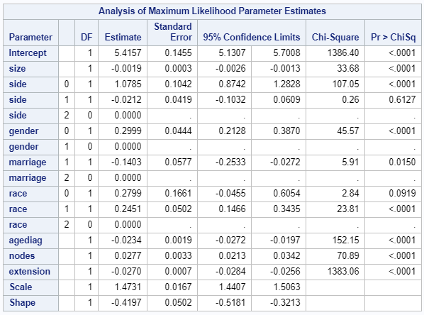
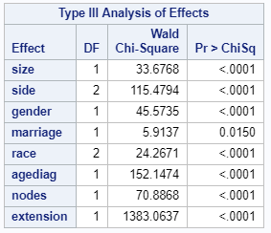
Lifetreg-Result

Slide 13
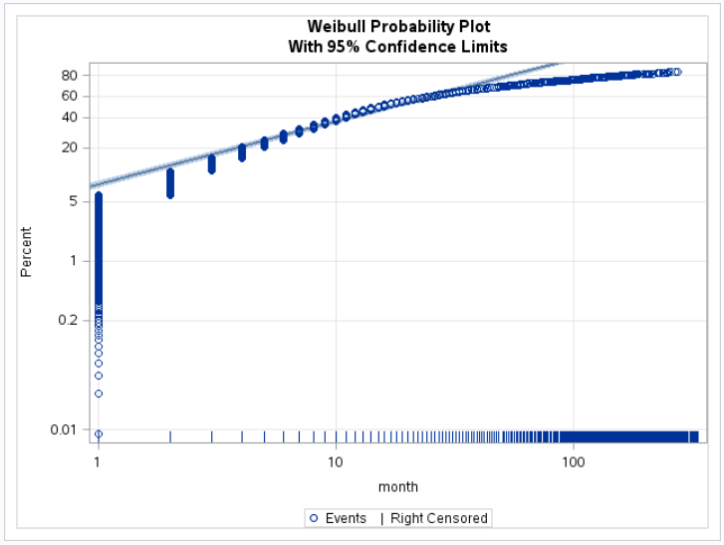

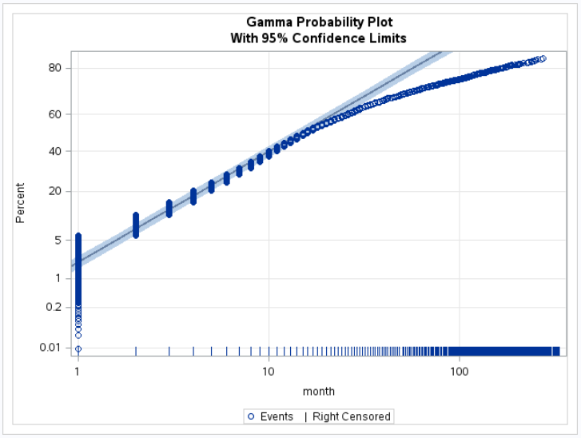
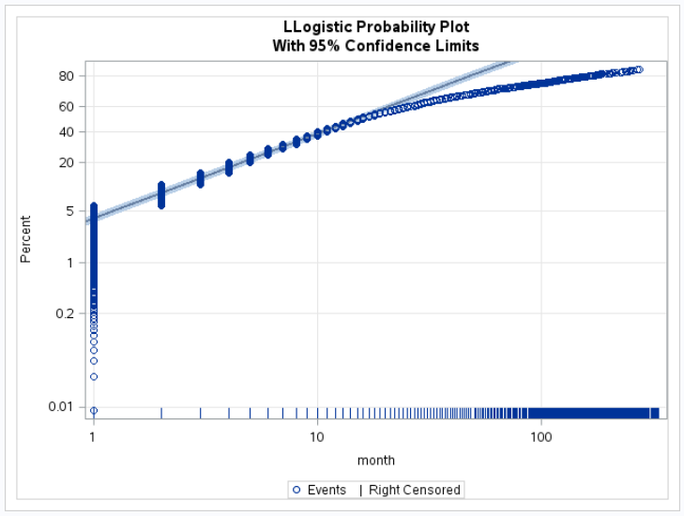
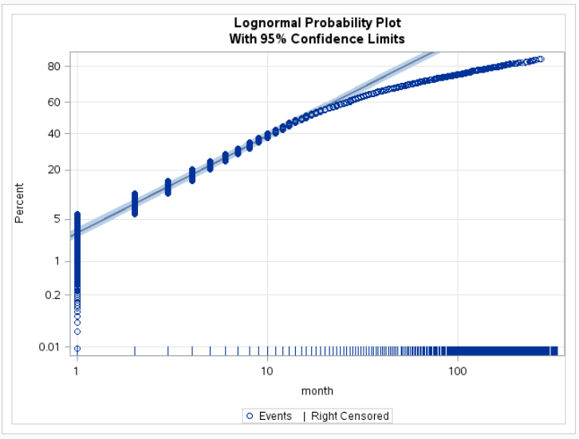
Lifereg-Result

Slide 14
Phreg-Result

Slide 15
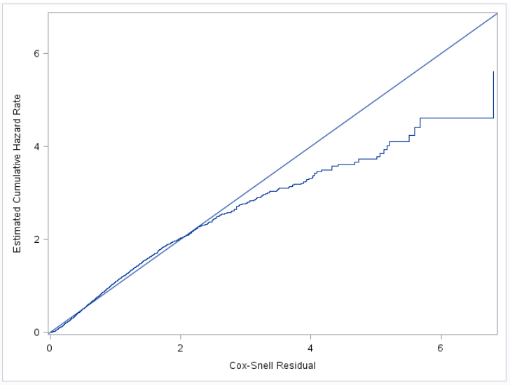
Phreg-Result
Overall Cox-Snell Residual

Slide 16
Phreg-Result

Slide 17
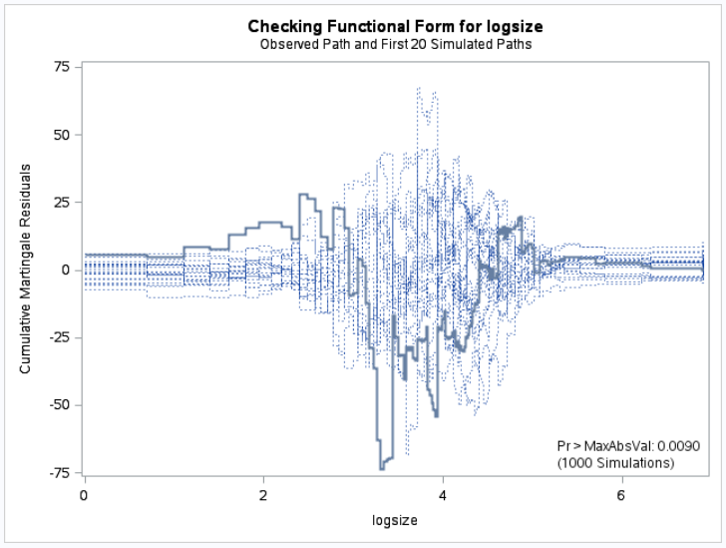

Phreg-Result
Log transformation on size

Slide 18
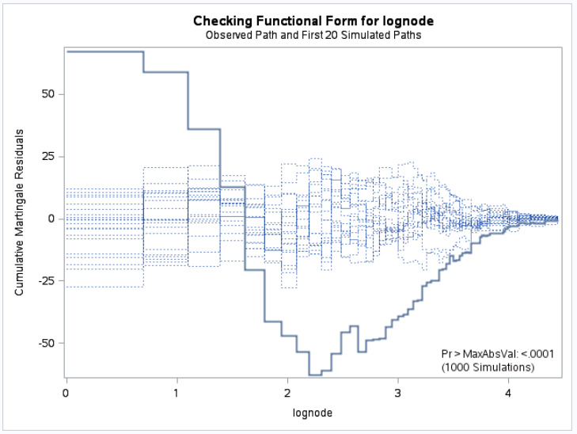

Phreg-Result
Log transformation on number of nodes

Slide 19
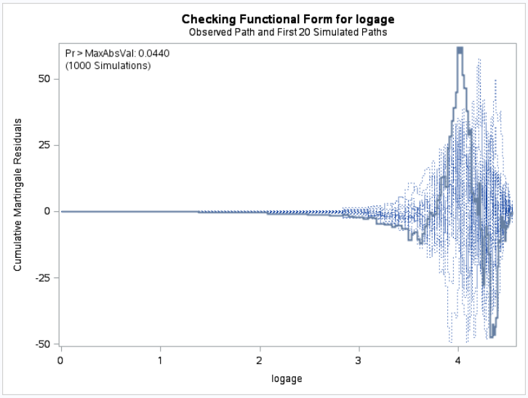

Phreg-Result
Log transformation on age

Slide 20
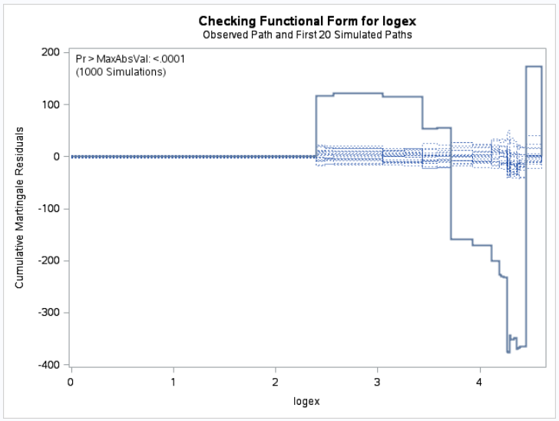

Phreg-Result
Log transformation on extension

Slide 21
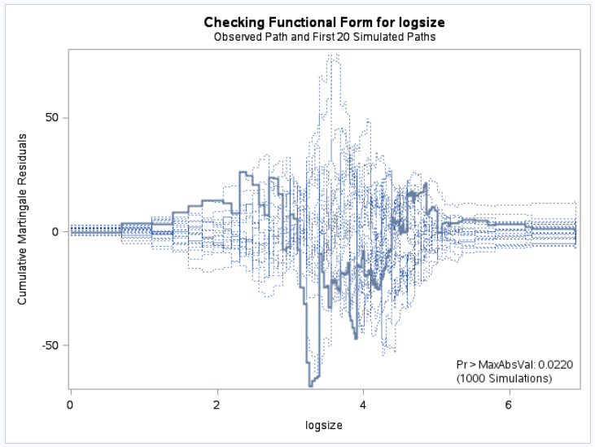

Phreg-Result
Interesting Facts
Log(size+1)
Log(size)

Slide 22
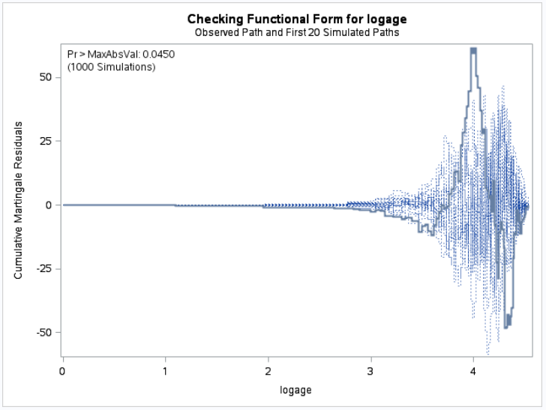

Phreg-Result
Redo the Age transformation
Log(age+1)
Log(age)

Slide 23
Phreg-Result
Summary of transformation:
Log transformation with age and size.
Other transformation might need to apply on number of nodes and extension.

Slide 24
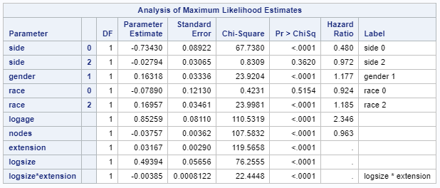

Phreg-Result
Stepwise Selection

Slide 25
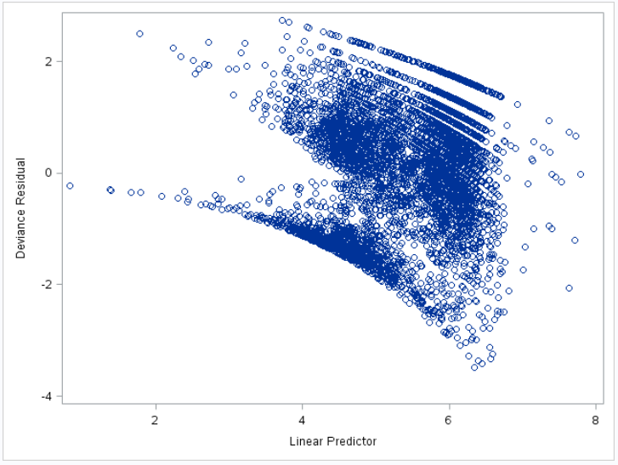
Phreg-Result
Outlier?
No large absolute value: No outlier

Slide 26
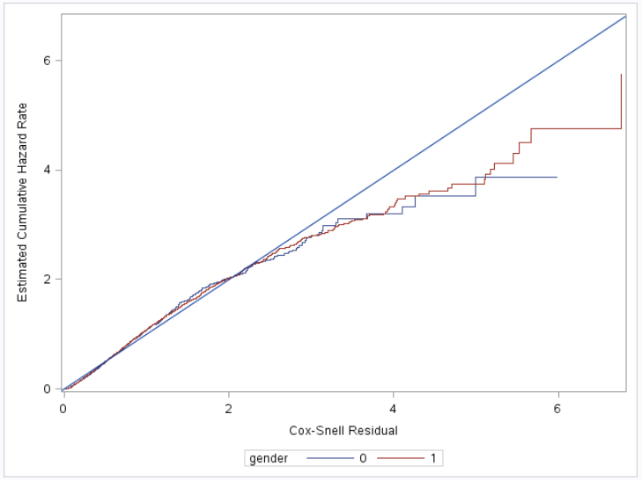
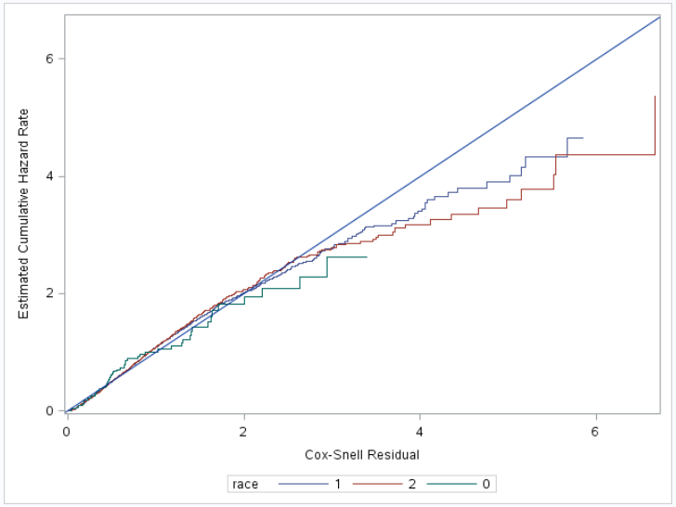
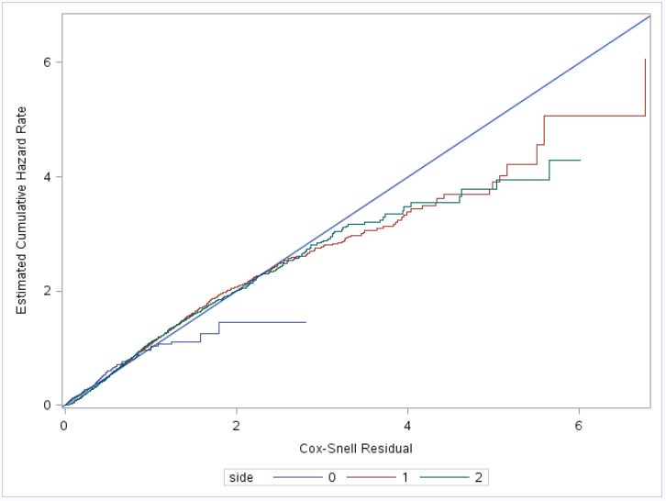
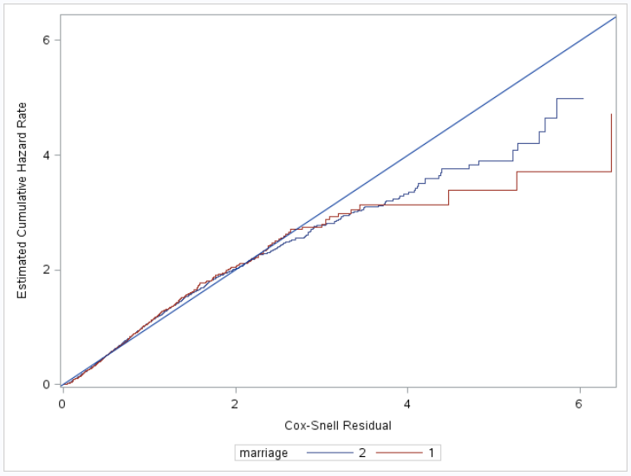
Phreg-Result
Strata?
Gender
Race
Side
Marriage

Slide 27
Conclusion
From lifetest result:
Marriage status are not influence the cancer.
0 side has significant different to left side and right side.
White and Black are significantly different to each other but has no difference to other type of race.
From phreg result:
Ph assumption seem hold.
Log transformation on age and side.
Logsize*extension need to include.
No outlier.
No need for stratified model.

Slide 28
Thank you
Any questions?

